Slide 1
  Lesson 2: Manager, Book Of Business, and Others

Slide 2

Objectives
By the end of this course, you will be able to:
  Explain Physical Producer Data Model.
  Describe Manager and its related Data.
  Create and modify Producer, Position, Relationship
  Identify Mandatory fields
  Explain backend tables and their relationship with Producer.
Notes:
By the end of this course, you will be able to:
Explain Physical Producer Data Model.
Describe Manager and its related Data.
Create and modify Producer, Position, Relationship
Identify Mandatory fields
Explain backend tables and their relationship with Producer.

Slide 3
Manager - Producer and Related Data
Producer Detail
  Contact Search
  Position
  License
  Affiliation
  Appointment
  Insurance
  Verification
  Education
  Beneficiary
Producer (SSN/TIN)
Address
Contract
License
Appointment
Education
Notes:
Producer and its interrelated details.

Slide 4
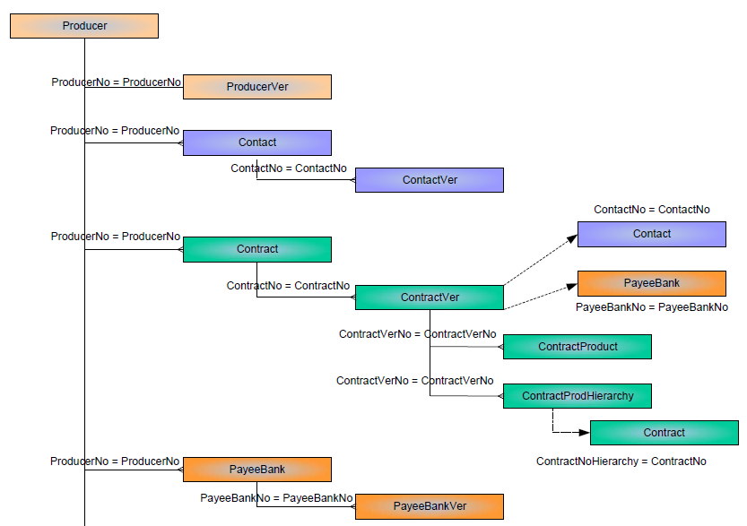
Producer – Physical Data Model
Notes:
Let’s have a look at the Physical Data Model of Producer and its related data.

Slide 5
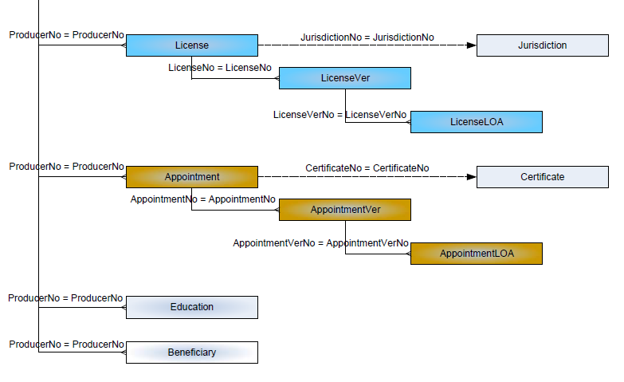
Producer – Physical Data Model (Continued)

Slide 6
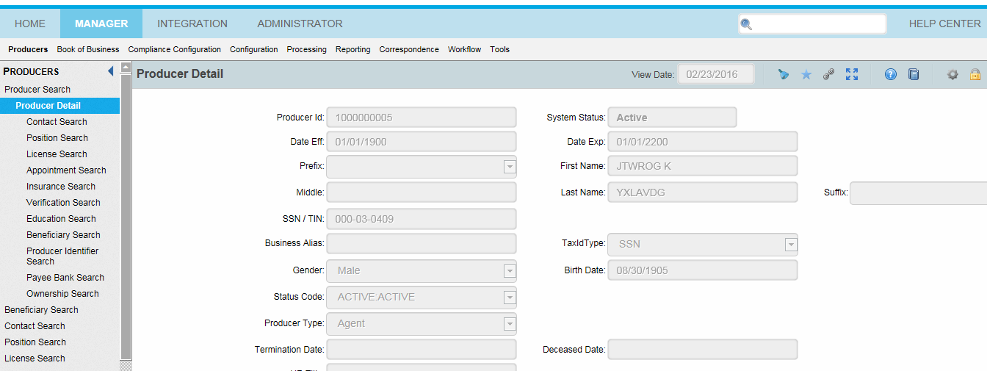
Producer and Related Data
Notes:
Now let’s look at the Producer screen and the interrelated data displayed.

Slide 7
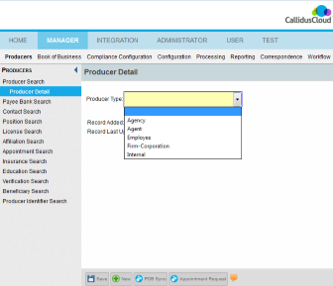
Creating a New Producer
Producer can be of the following types: Agency, Agent, Employee, Firm- Corporation and Internal.
Step 1: Select the producer type from the list.
Step 2: Click New at the bottom of the screen.
New Producer
Notes:
Producer can be of the following types. viz Agency, Agent, Employee, Firm- Corporation and Internal.
Step 1: Select the producer type from the list.
Step 2: Click New at the bottom of the screen.

Slide 8
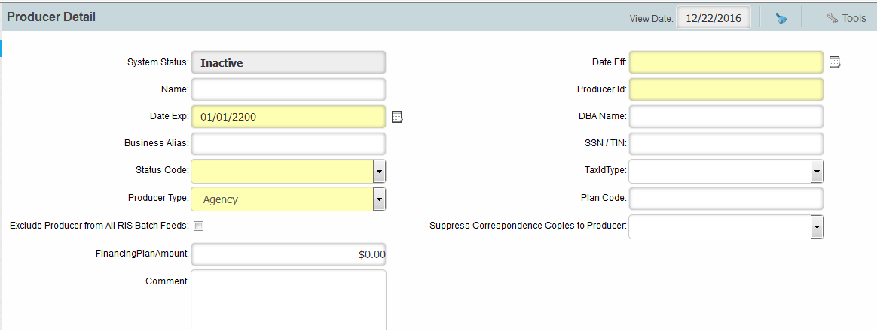
Creating a New Producer
  After choosing the Producer Type and clicking New button, the below screen appears.
Notes:
After choosing the Producer Type and clicking New button, the below screen appears.

Slide 9
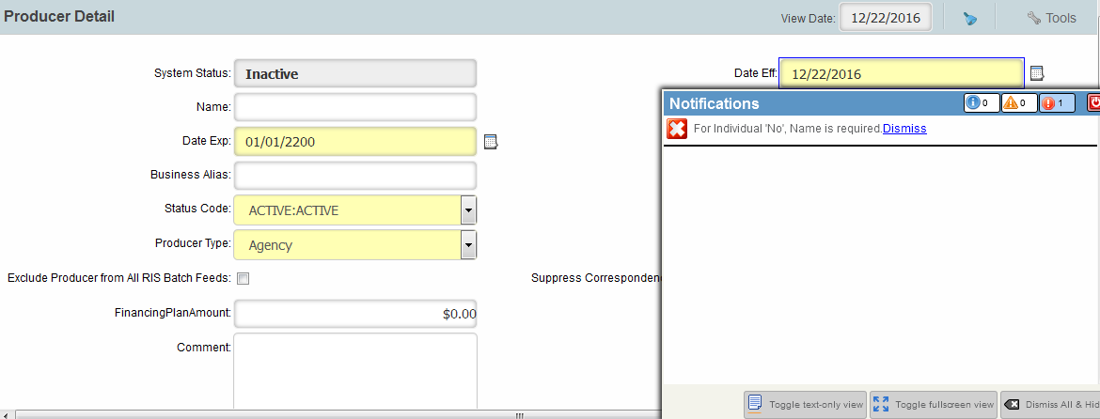
Creating a New Producer
  The fields marked in yellow are mandatory fields. Producer Id field is the unique field which gets auto generated through a query which is written by Callidus and needs to be executed always after each environment refresh.
  Based on the Producer Type selected, a few other fields would be mandatory as well.
  Step 3: Type the necessary values in each mandatory field and click the Save button. A pop-up error message will appear.
Notes:
Mandatory fields are marked in “Yellow”. “Producer Id” field is the unique field which gets auto generated through a query which is written by Callidus and needs to be executed always after each environment refresh.
Few more fields are mandatory based on the “Producer Type” selected, once you try to click on “SAVE” button a pop-up appears with the error message.

Slide 10
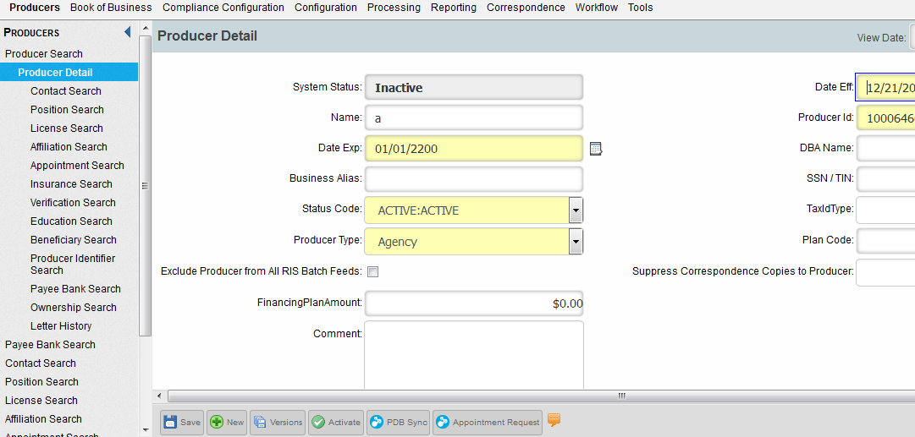
Producer Traversing (Continued)
  Step 4: Type the values in the fields mentioned in the pop-up and click the Save button.
  Step 5:Click the Activate button. The record will remain Inactivate and no operations can be done until you click the Activate button.
Save
Activate
Notes:
After data addition, click on Save and Active button, else record will not be available for any actions.

Slide 11
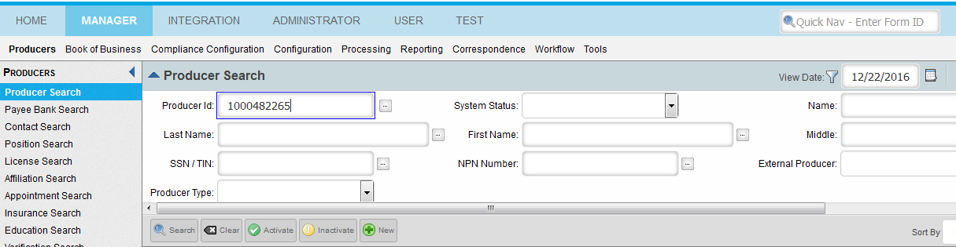
Producer Search
  Step 1: Click Producer Search.
  Step 2: Enter the ProducerId in “ProducerId” field.
  Step 3: Click the “Search” button and the details will get displayed.
Existing Producer Search
Notes:
To search an existing Producer. Enter the ProducerId in “ProducerId” field.

Slide 12
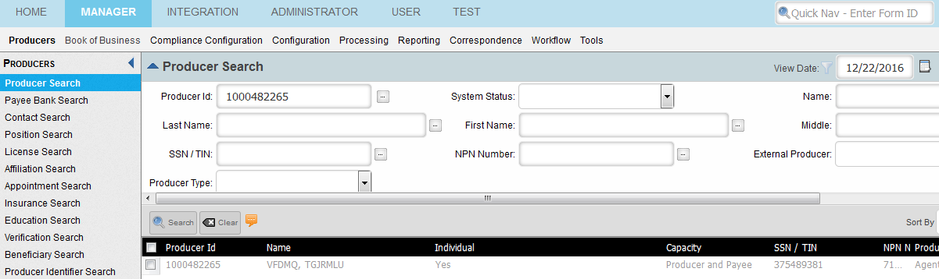
Producer Search – View Date Filter
  If the record cannot be seen, disable the “View Date” filter, and change the date as per the calendar shown and give the date of the Producer.
Change Date
Off/On Filter
Notes:
If the record cannot be seen then disable the “View Date” filter, and change the date as per the calendar shown and give the date of the Producer.

Slide 13
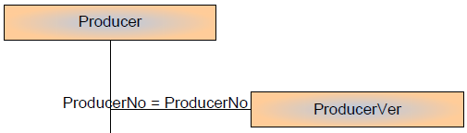
Backend Tables
The backend tables involved for Producer and related entities are:
Producer Table – Holds ProducerID, user details, creation/updation dates and ProducerNo (Primary Key of the table), which acts as a foreign key to ProducerVer table.
ProducerVer Table – Holds all the Producer related attributes and is joined with Producer table with ProducerNo. The Unique key is ProducerVerNo. All versioning is done in ProducerVer table.
Data Model
Notes:
The backend tables involved for Producer and related entities. All pmpro tables have few Standard fields (defined by Callidus and provided as a product feature, this cannot be added/deleted/modified) and rest are Custom fields which can be added/deleted/modified.

Slide 14
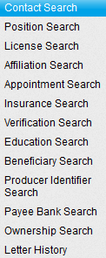
Backend Tables (Continued)
All the related entities can be accessed through ProducerVer table using ProducerNo field.
Notes:
All the related entities can be accessed through ProducerVer table using ProducerNo field.

Slide 15
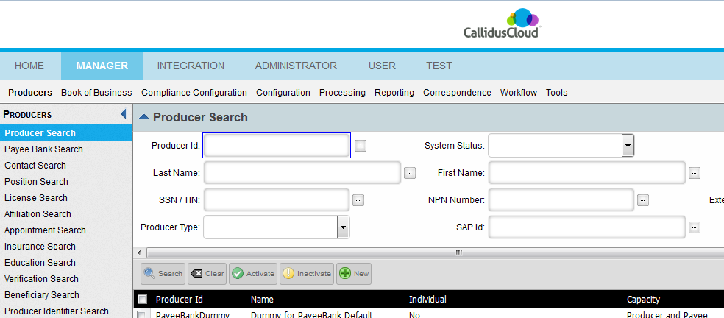
Individually Creating Entities
You can also create individually each of the entities related to Producer.
Notes:
You can also create individually each of the entities related to Producer.

Slide 16
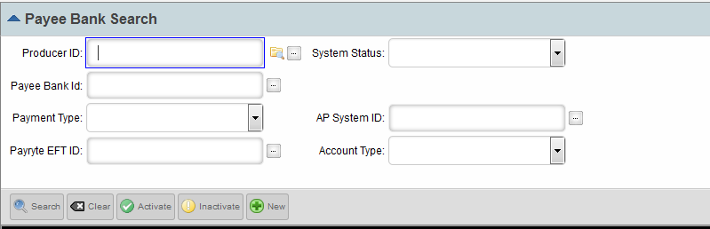

Payee Bank Detail
To create or search Payee Bank Detail, Select ProducerID from the Search box (Arrow in Red).
Select Producer ID
Data Model
Notes:
To create/search Payee Bank Detail, Select ProducerID from the Search box (Arrow in Red).

Slide 17
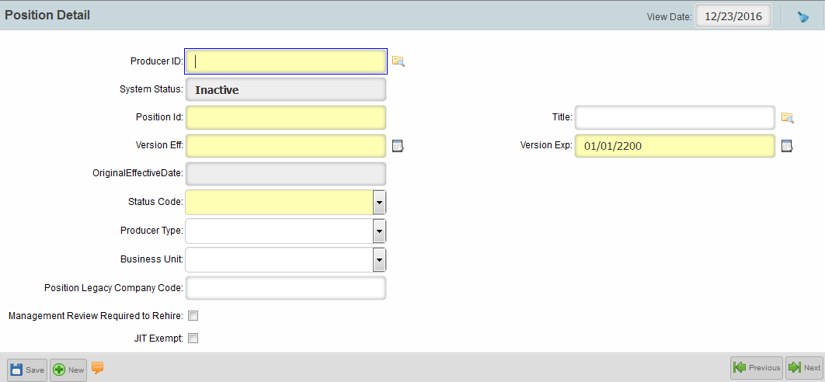
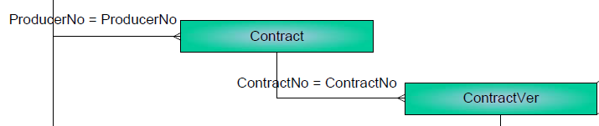
Position/Contract Detail
To create or search Position/Contract Detail:
Step 1: Select ProducerID from the search box.
Step 2: Select Title from the Search box
Select Producer ID
Select Title
Data Model
Notes:
To create or search Position/Contract Detail, both ProducerID and Title needs to be selected from drop-down list.

Slide 18

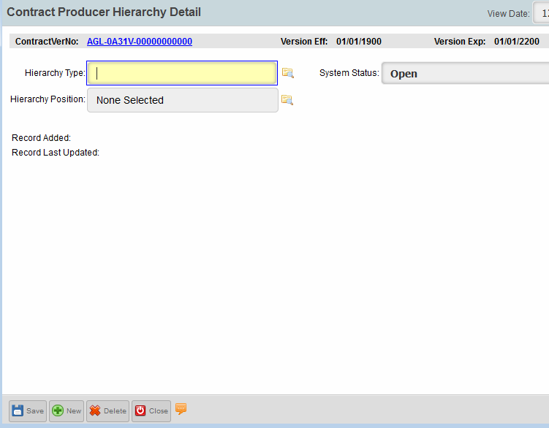
Contract Relationships – Step 1
  The steps for creating any new hierarchy are:
Add
Step 1:-
Select Hierarchy Type
Notes:
The steps for creating any new hierarchy are shown on screen.

Slide 19
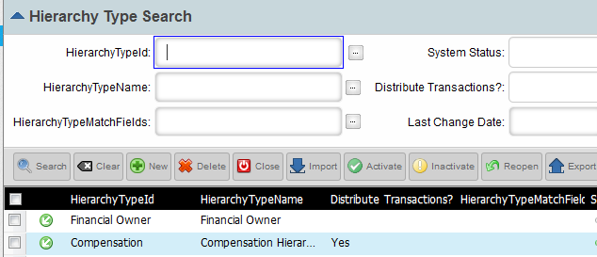
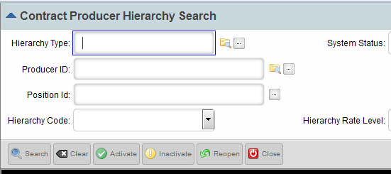
Contract Relationships – Steps 2 & 3
Step 2:-
Step 3:-
Click on Green Arrow

Slide 20
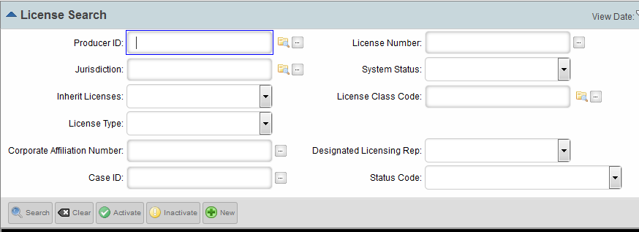
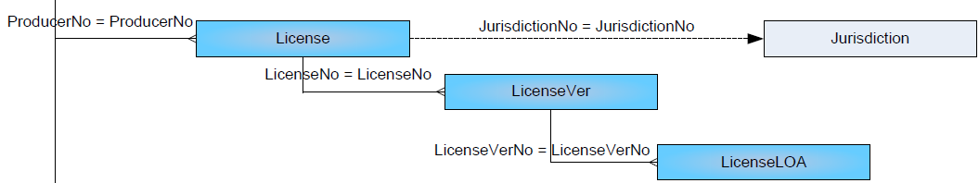
License Detail
To create/search license detail:
Snapshot of License Data
Data Model
Notes:
Let us learn how to create/search License Detail .

Slide 21
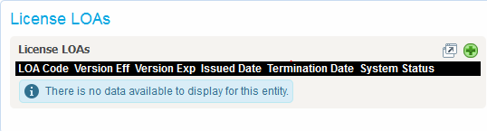
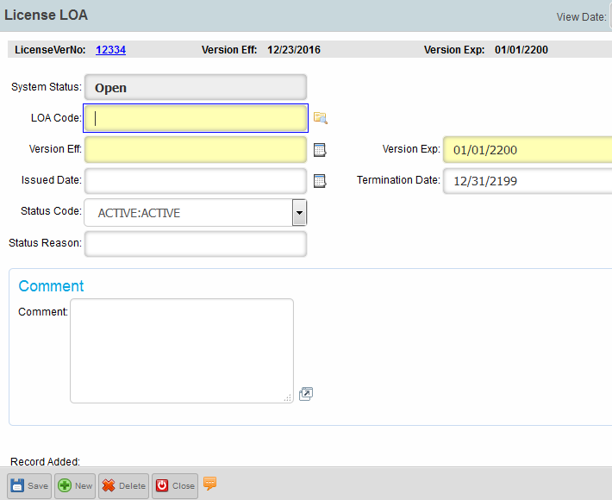
License Detail
This screen will appear after you save the new license.
Notes:
This screen will appear after you save the new license.

Slide 22
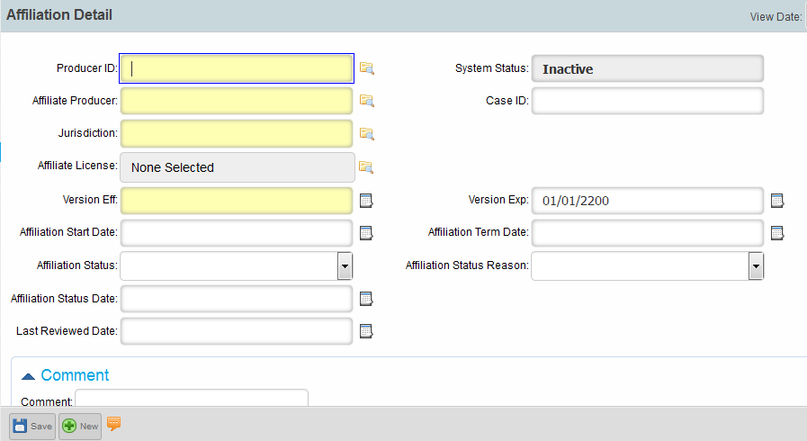
Affiliation Detail
To create/search affiliation detail:
Notes:
Let us learn how to create/search affiliation detail.

Slide 23
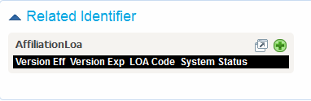
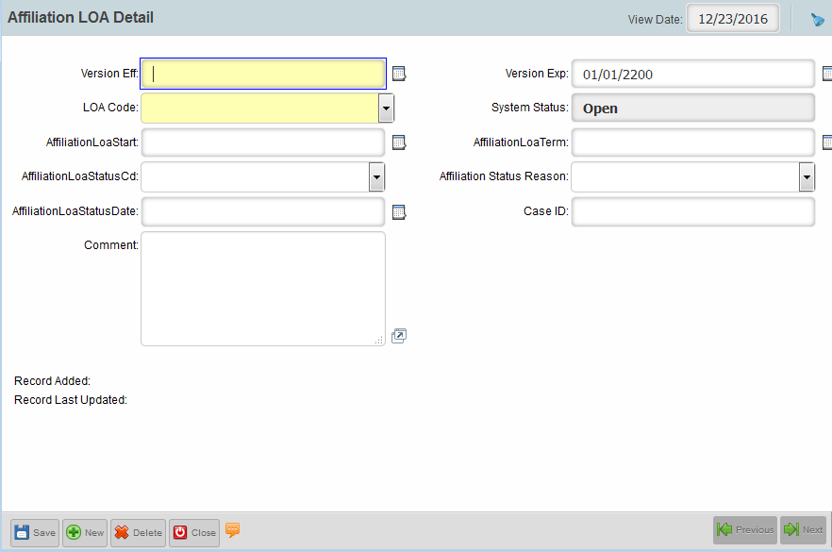
Affiliation Detail
This screen will appear after you save the new affiliation.
Notes:
This screen will appear after you save the new affiliation.

Slide 24
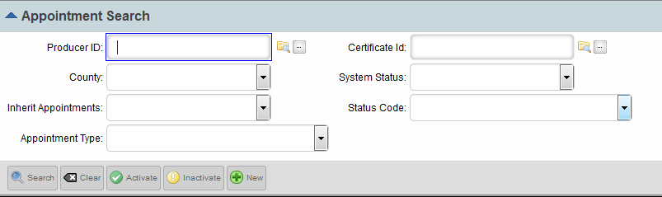
Appointment Detail
To create/search appointment detail:
Notes:
Let us learn how to create/search appointment detail.

Slide 25
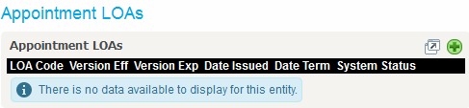
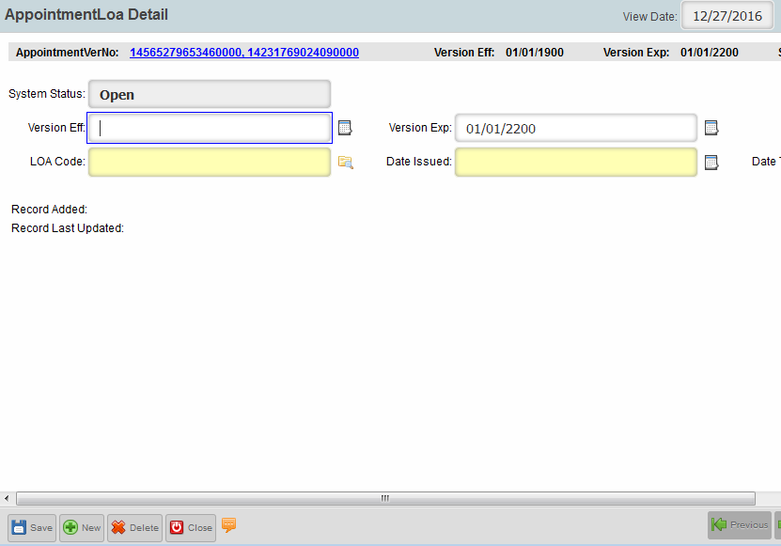
Appointment Detail
This screen will appear after you save the new appointment.
Notes:
This screen will appear after you save the new appointment.

Slide 26
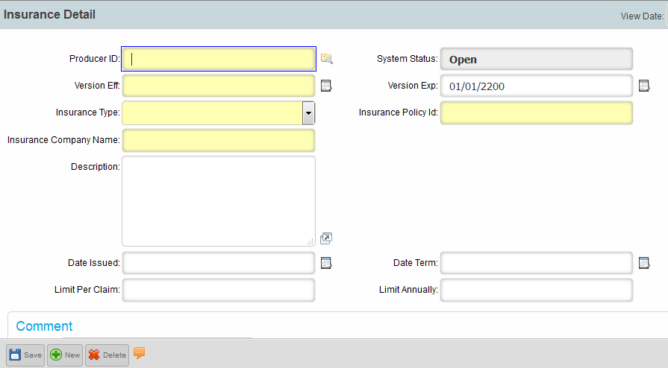
Insurance Detail
To create/search insurance detail:
Notes:
Let us learn how to create/search Insurance detail.

Slide 27
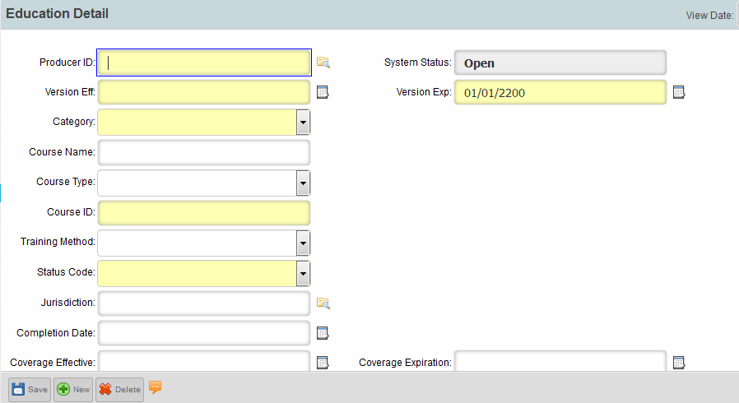
Education Detail
To create/search education detail:
Notes:
Lets learn how to create/search Education Detail.

Slide 28
Test Your Understanding
  Which among the following are types of Producer?
Notes:
Now, its time to test your understandings..

Slide 29
Test Your Understanding
  Can we create LOAs before creating Affiliation/License?
Notes:
Now, its time to test your understandings..

Slide 30
Test Your Understanding
  How can we identify “Mandatory” fields in each workspace?
Notes:
Now, its time to test your understandings..

Slide 31
Test Your Understanding
  Can a Position get created before Producer creation?
Notes:
Now, its time to test your understandings..

Slide 32
Test Your Understanding
  How many types of Producer are there?
  How to create Hierarchy relationships?
  Can we create LOAs before creating Affiliation/License?
  How can we understand “Mandatory” fields in each workspace.
  How are tables related to each other?
Notes:
Now, its time to test your understandings..

Slide 33
Summary
You should now be able to:
  Explain Physical Producer Data Model.
  Describe Manager and its related Data.
  Create and modify Producer, Position, Relationship
  Identify Mandatory fields
  Explain backend tables and their relationship with Producer.
Notes:
You should now be able to:
Explain Physical Producer Data Model.
Describe Manager and its related Data.
Create and modify Producer, Position, Relationship
Identify Mandatory fields
Explain backend tables and their relationship with Producer.

